Slide 1

Need Finding

Slide 2
Contents
01
02
Team Intro
Domain Selection
03
04
Need Finding methodology
Interview Results
05
06
Empathy Maps
Summary

Slide 3
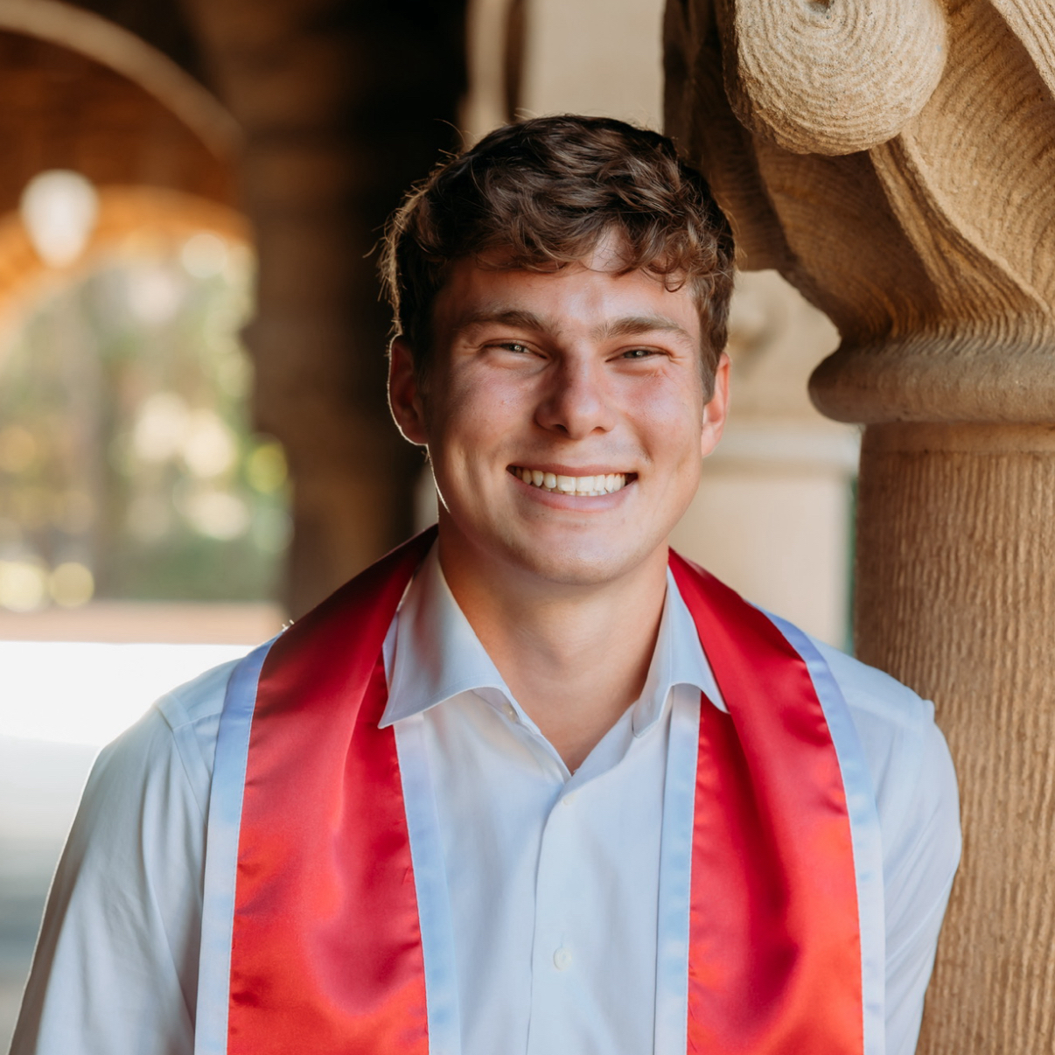

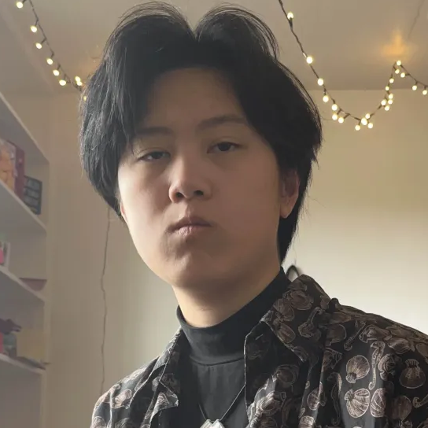

Meet the team
Anthony R.
Luke M.
Fei W.
Isaac P.
Co-term in Computer Science on the HCI track. Did my undergraduate in Economics. Born and raised in New York City.
Undergrad studying Computer Science on the HCI track. Member of the varsity Men’s Volleyball team.
Undergrad studying Computer Science, track undeclared. Visual artist and musician.
Co-term in Computer Science. Senior in Economics. Grew up in New Jersey.

Slide 4
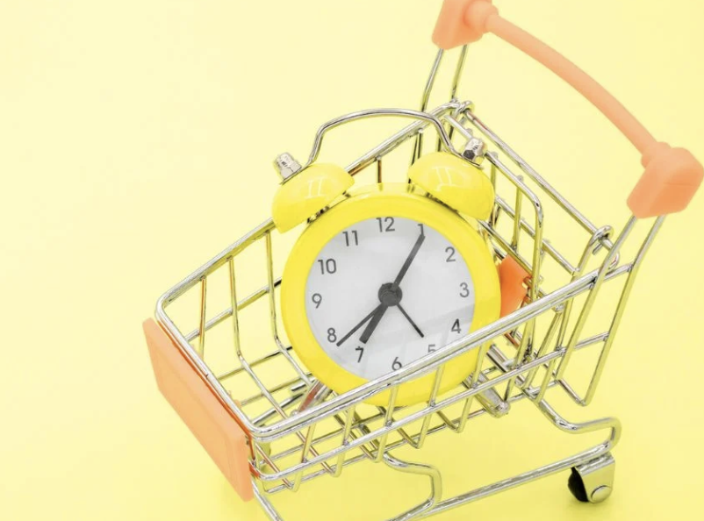
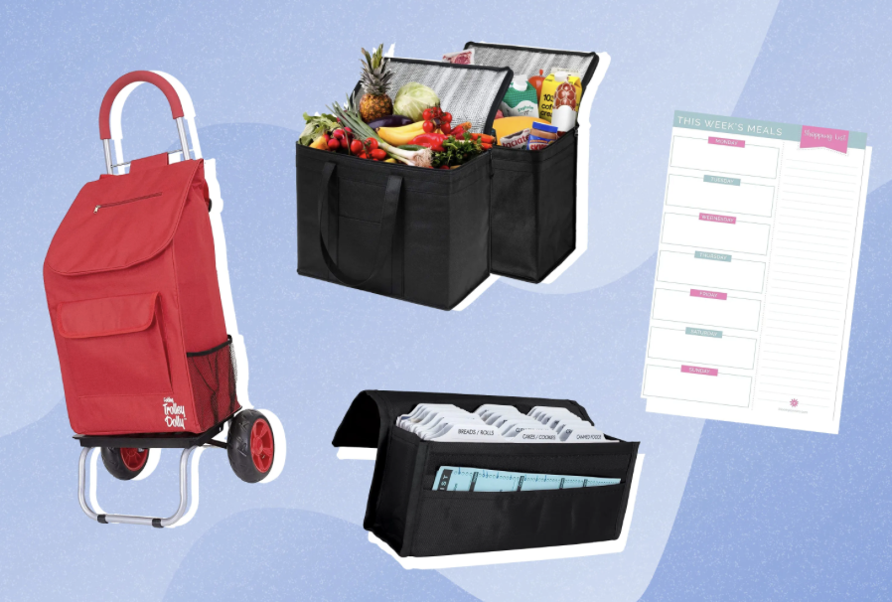
Domain Background
Chore Shopping Made Easier
How did we come up with this
  Frustrated shopping experiences while buying things as school started
  Would forget something
  Lack of transportation
Became important to us to save time, money, and improve our process of buying the things we need
Date

Slide 5
Visit Stores
Met Incoming Shoppers
Extreme User: “Candace”
Methodology
01
02
03
We split up into two different groups and went to a variety of stores around the area.
We went to a variety budget tier stores including Target, Whole Foods, Walmart, and Sur la Table.
As shoppers came into the stores, we would ask if they were available to be interviewed while they shopped.
We had one person take notes and record the conversation on their phone while the other asked questions.
Our extreme user, “Candace”, is a teacher, wife, and self proclaimed “pro shopper”. She consistently buys items in bulk for her classroom.
She had over 10 different shopping apps, followed shopping gurus on social media, and is determined to find any deal possible.
Date
Notes:
Add in details about the questions we asked and why those questions
Kind of questions we wanted to ask:
How and why did they come this story? Why not online
Stories about times they were frustrated / enjoyed the shopping experience
What prompted you to make your shopping list? Do you forget anything, leave anything out?
How did you learn how to shop? What tips did you pick up on?

Slide 6
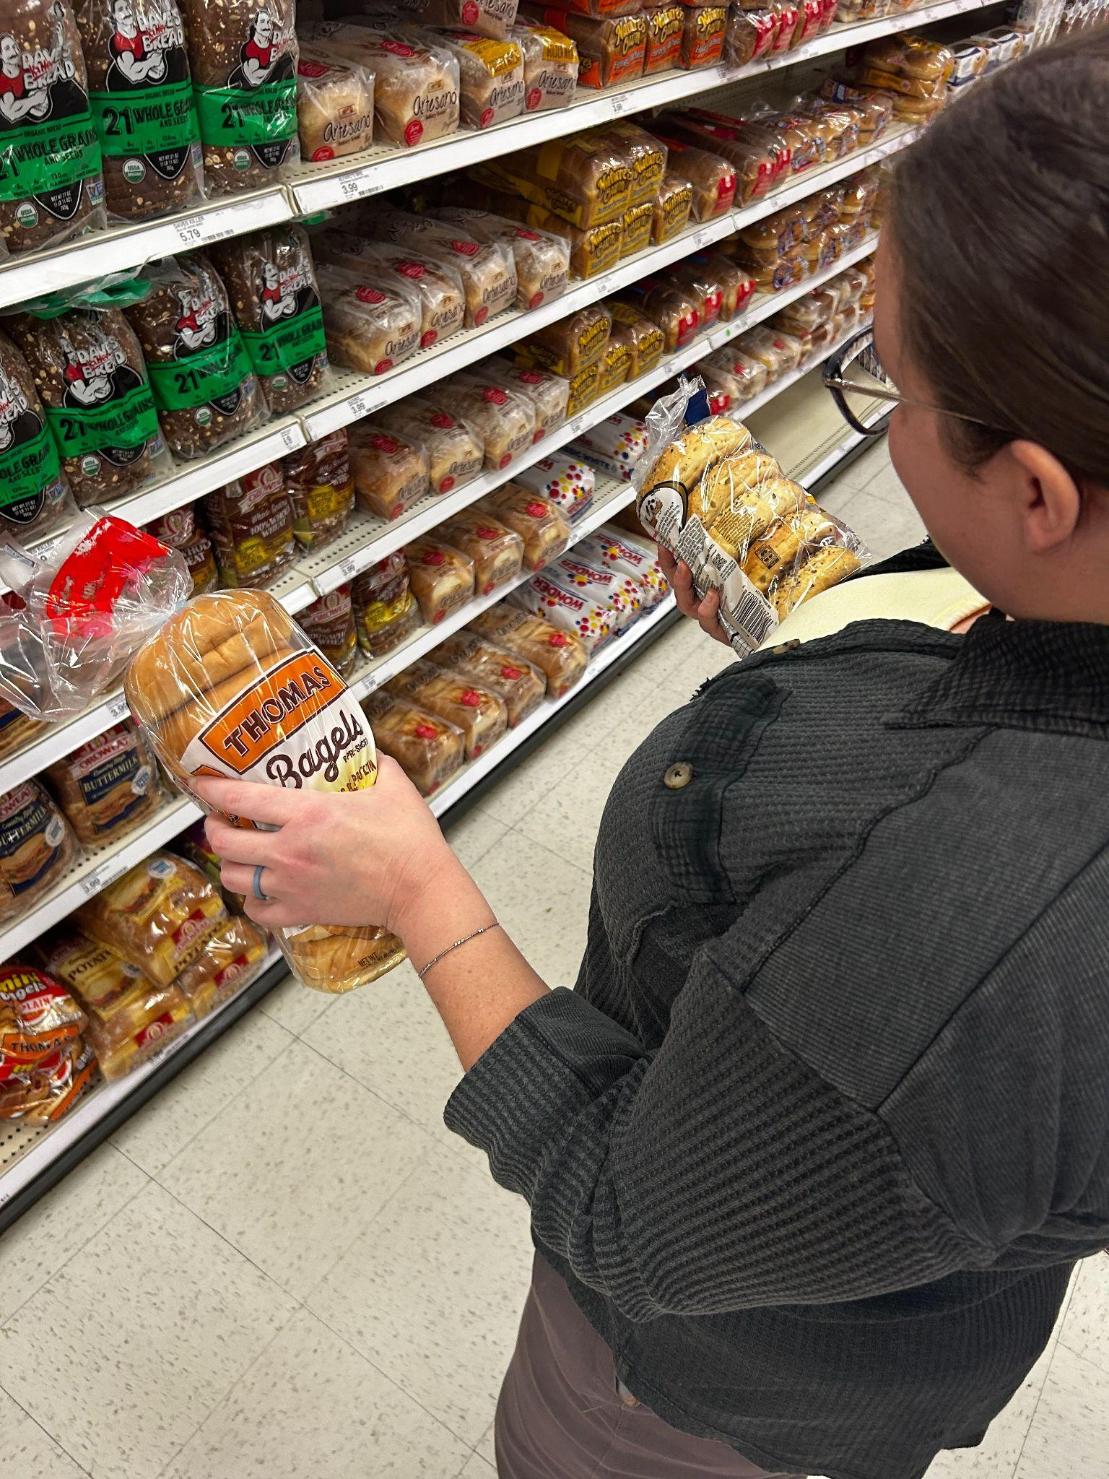
Results of Interview 1
Who?
  Teacher from the Fresno area
  Extreme User
  Shops for herself, husband, friends, and students
  Self proclaimed “pro shopper”
Where?
  Target
  Morally conflicted shopping at Target but low prices
Why?
  Currently having a clearance sale for Halloween
  Wanted to buy clothes and supplies for classroom
Deal hunter
  Has 10+ apps for shopping and deals
  Follows shopping gurus on social media
Artifact
  Choosing between two different types of Bagels
Date
Notes:
We met with “Candace” at Target on Monday morning. She’s a teacher from the Fresno who is visiting Palo Alto because her husband is in the hospital. While not from the area, she came to this target to shop for clothes and her classroom back home.
As we talked with Candace, we immediately learned that she was an experienced shopper, eventually proclaiming herself a “professional shopper” who prides herself on saving every dollar possible
She does this by buying items in bulk as much as possible, keeping a mental schedule for when potential clearance sales will be available, and taking advantage of coupons and loyalty programs
She will usually shop at big box stores but is morally conflicted by it because she considers big box stores unethical but “her dollar goes further here than local stores”.
As mentioned, she is a teacher who often shops for her classroom out of her own pocket. This is because the schools have to order from a set list of distributors where goods are more expensive, for example the school would have to pay $3.50 for notebooks whereas she only has to pay $50
She also mentioned that she will shop for other teachers or her friends
She is an experienced deal hunter who will go out of her way to find a good deal. She mentioned that she one time bought a pack of 30 glue sticks for her class for $5 at a thrift store when it cost almost $30 for one at staples
She looks to buy items in bulk as often as possible but when we asked why she doesn’t shop at places like Costco, she said that even despite getting extra rewards because her husband works for costco, costco has limit availability and often doesn’t have what she needs
It became pretty clear of the course of the interview that she gets an emotional response from saving money while shopping and takes pride in skills as a shopper

Slide 7
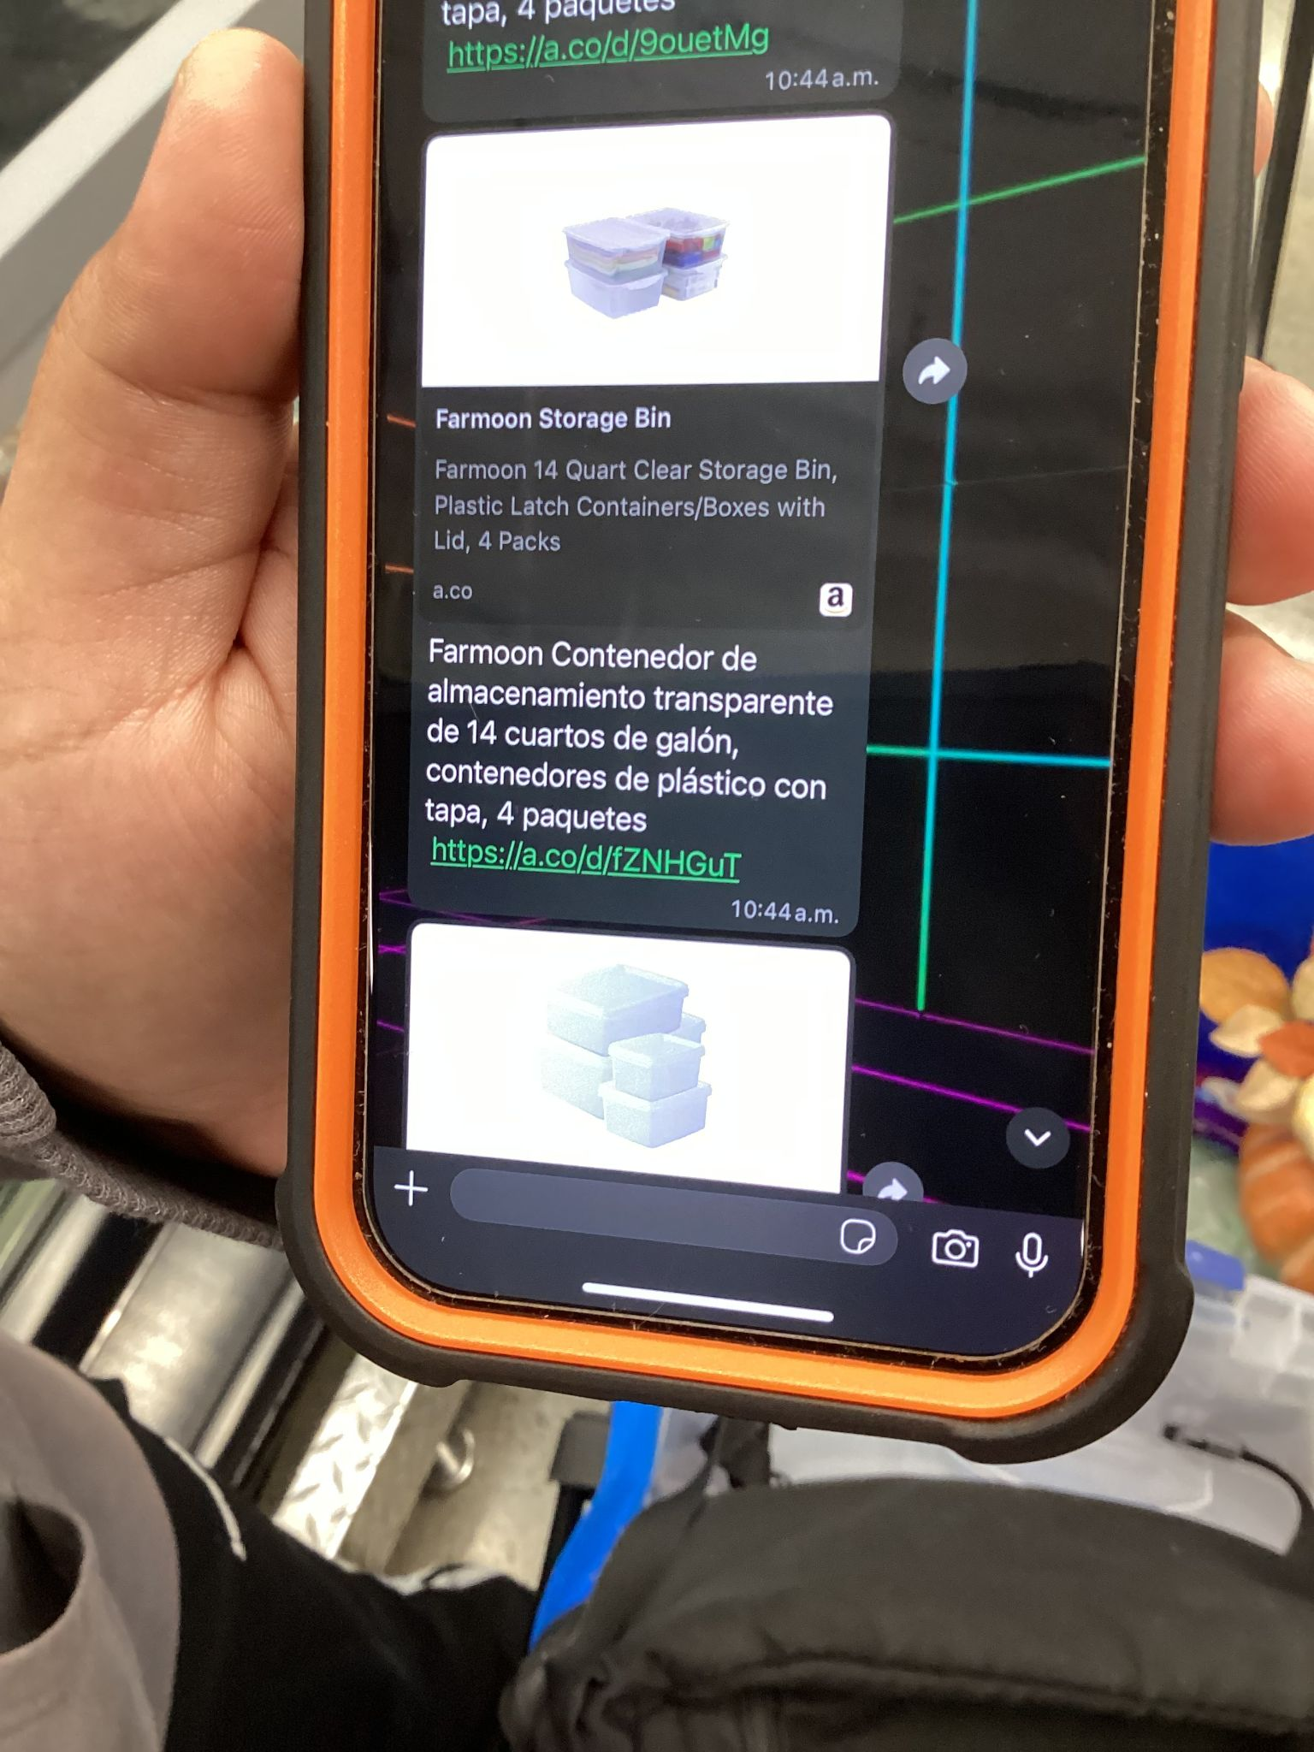
Results of Interview 2
Who?
  Shopper from Guatemala
  Shops for entire family with list that mother makes
  Walks to the store with his own shopping cart
Where?
  Walmart
  Cheaper than his preferred Spanish market
  Regular price at Walmart is cheaper than deals at Safeway
Why?
  Usually shops twice a week at Walmart for weekly groceries
Deal hunter
  Has a mental idea of which stores have cheaper prices
Artifact
  Mother sends grocery list on Whatsapp
  Personal shopping cart in background of photo

Slide 8
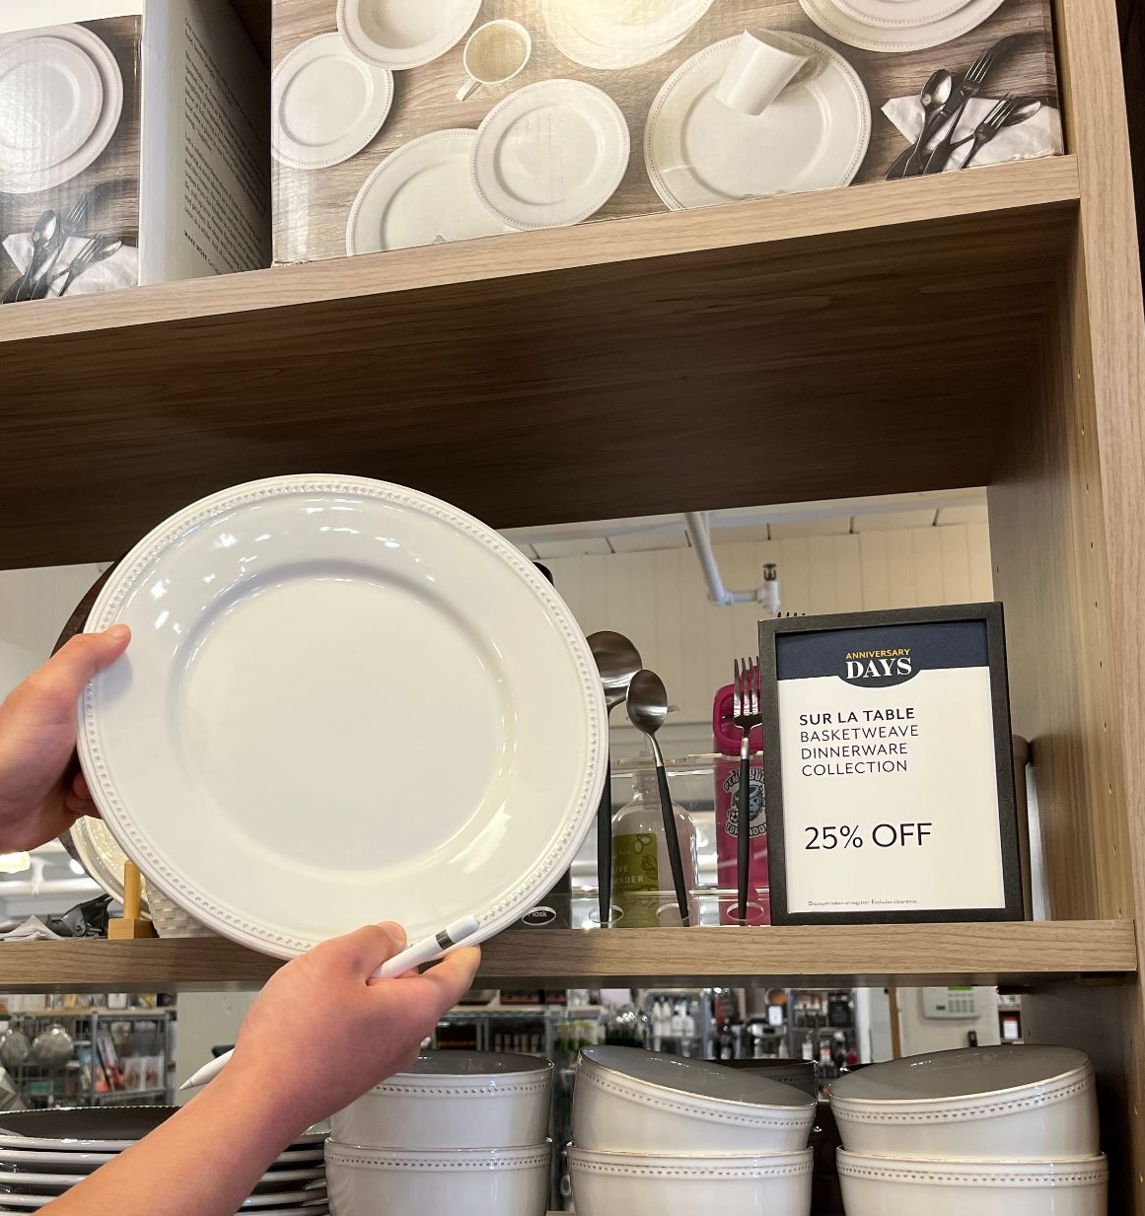
Results of Interview 3
Who?
  Non user
  Moved to Bay Area a couple years ago
  Wants to complete her 8-set plate collections
Where?
  Sur La Table
Why?
  Shopped today because there was a 25% sale on dinnerware
  Only time she bought items for full price was when she just moved and had no plates
Deal hunter
  Signed up to receive physical mailers to find out when the 25% sales are
Artifact
  Plate to complete her collection

Slide 9
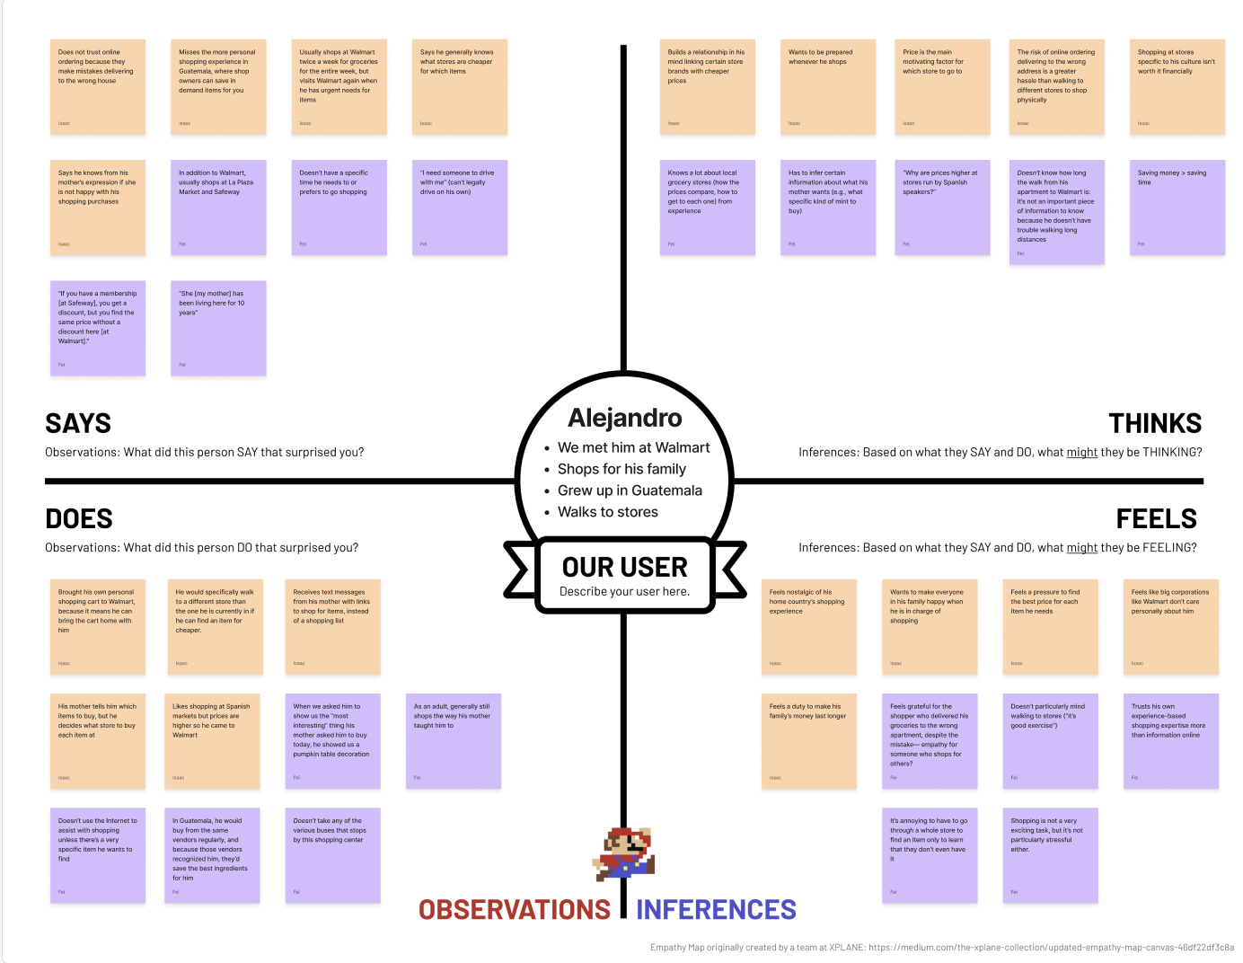
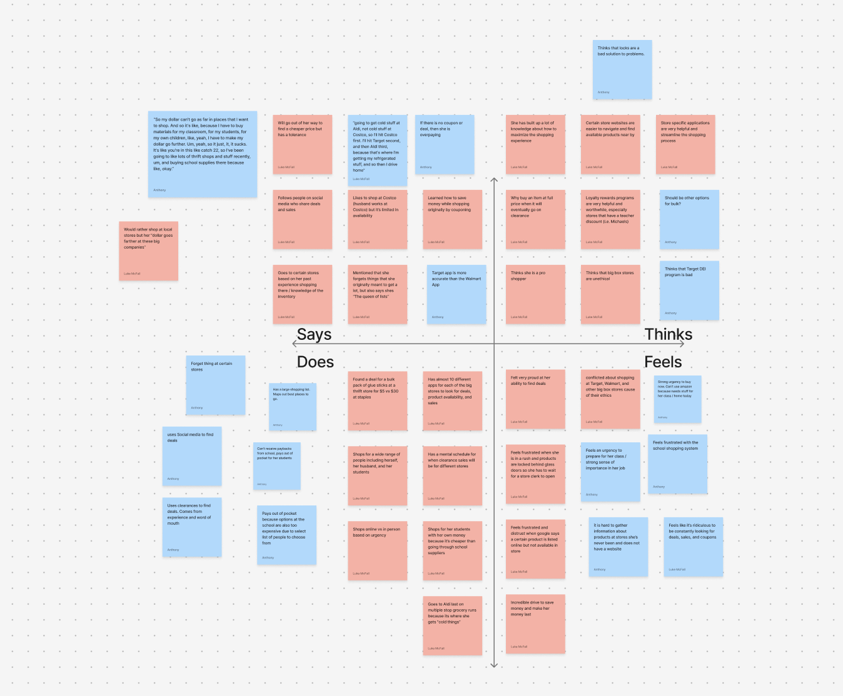
Empathy Maps
Date

Slide 10
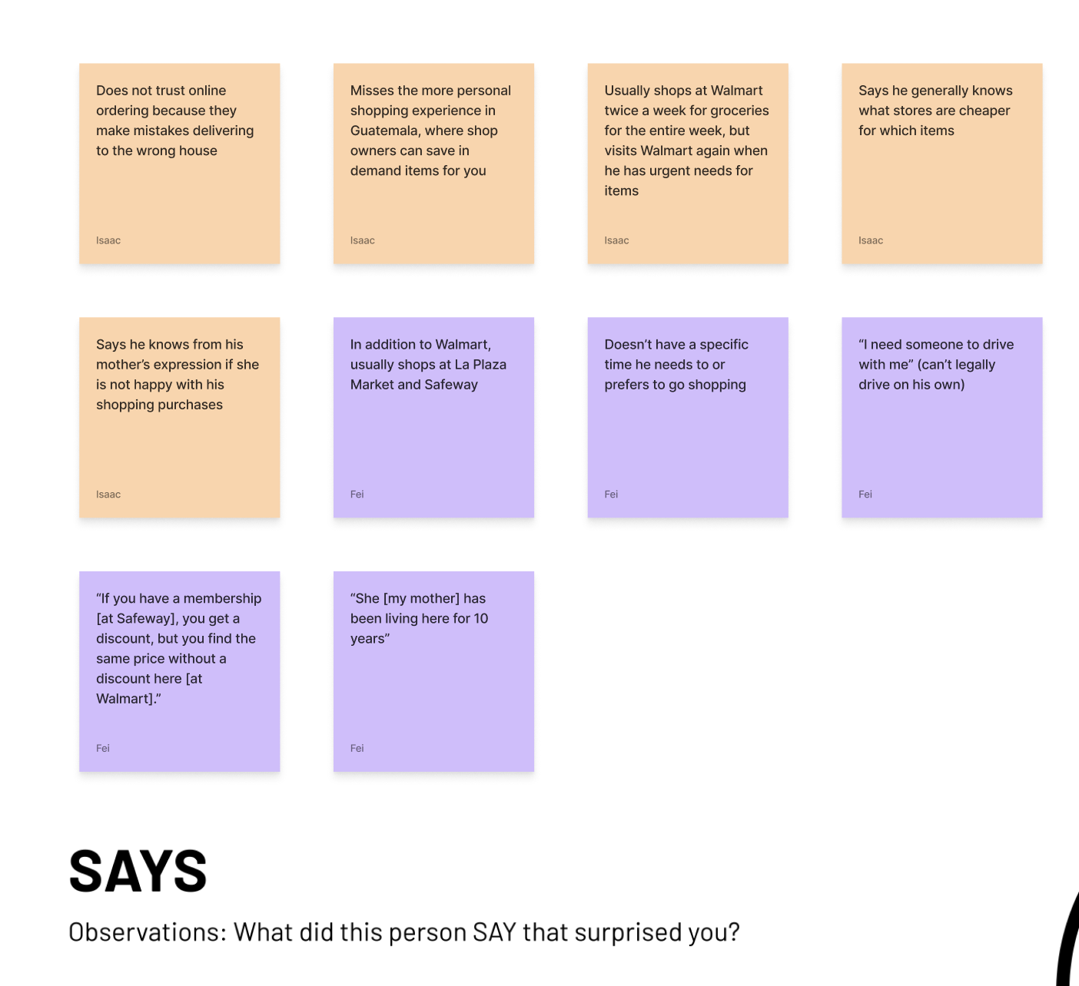
Empathy Maps
Says
Date
Notes:
Sees the deals at other stores, but knows its cheaper at Walmart
Knows what stores are cheaper
Say quotes out loud

Slide 11
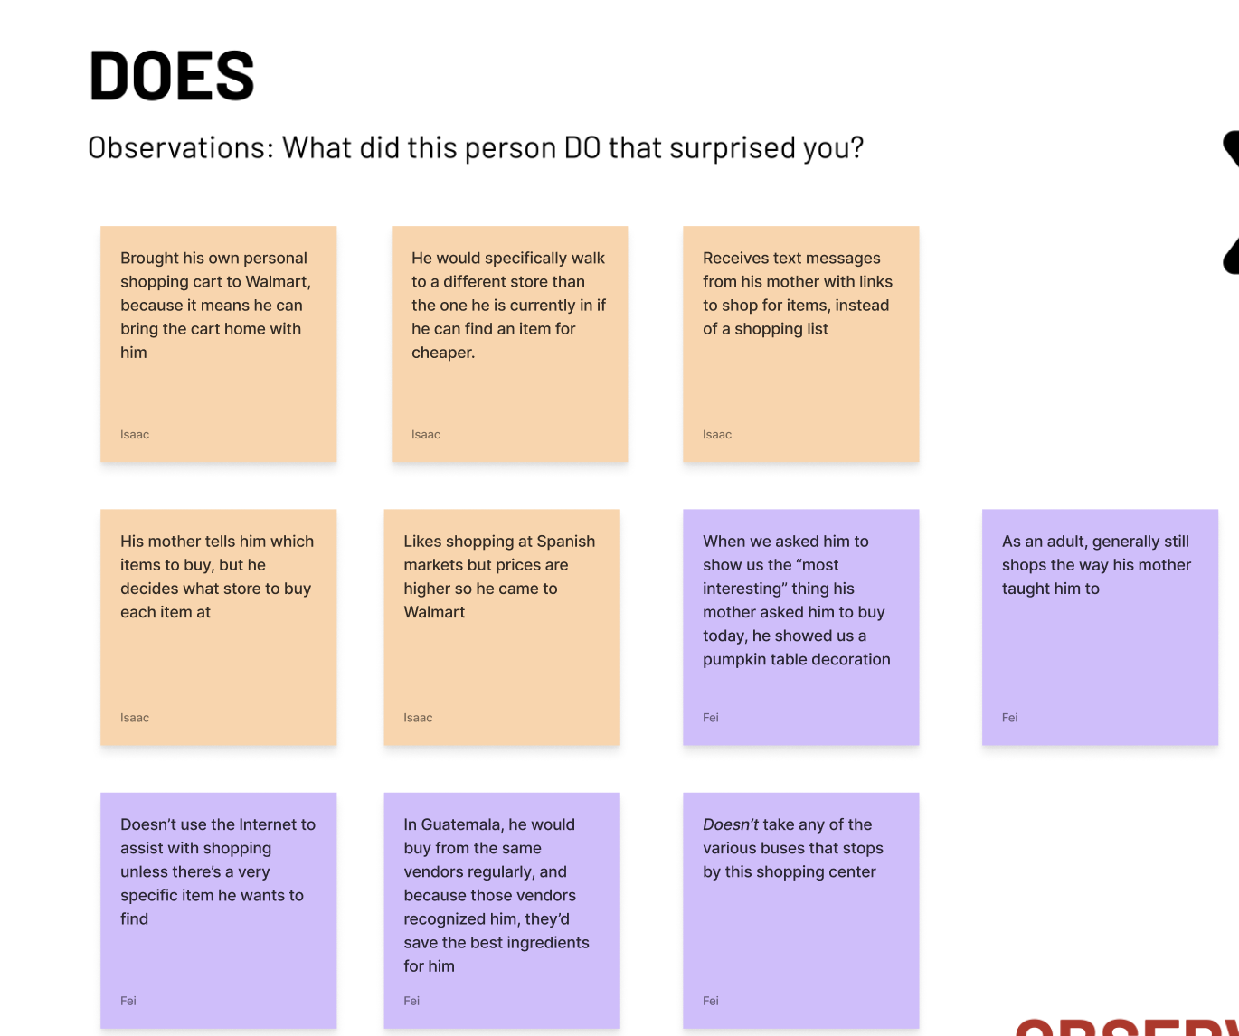
Empathy Maps:
Does
Date
Notes:
Walk to different store if its cheaper
Buys stuff for his whole family based on his mothers suggestions

Slide 12
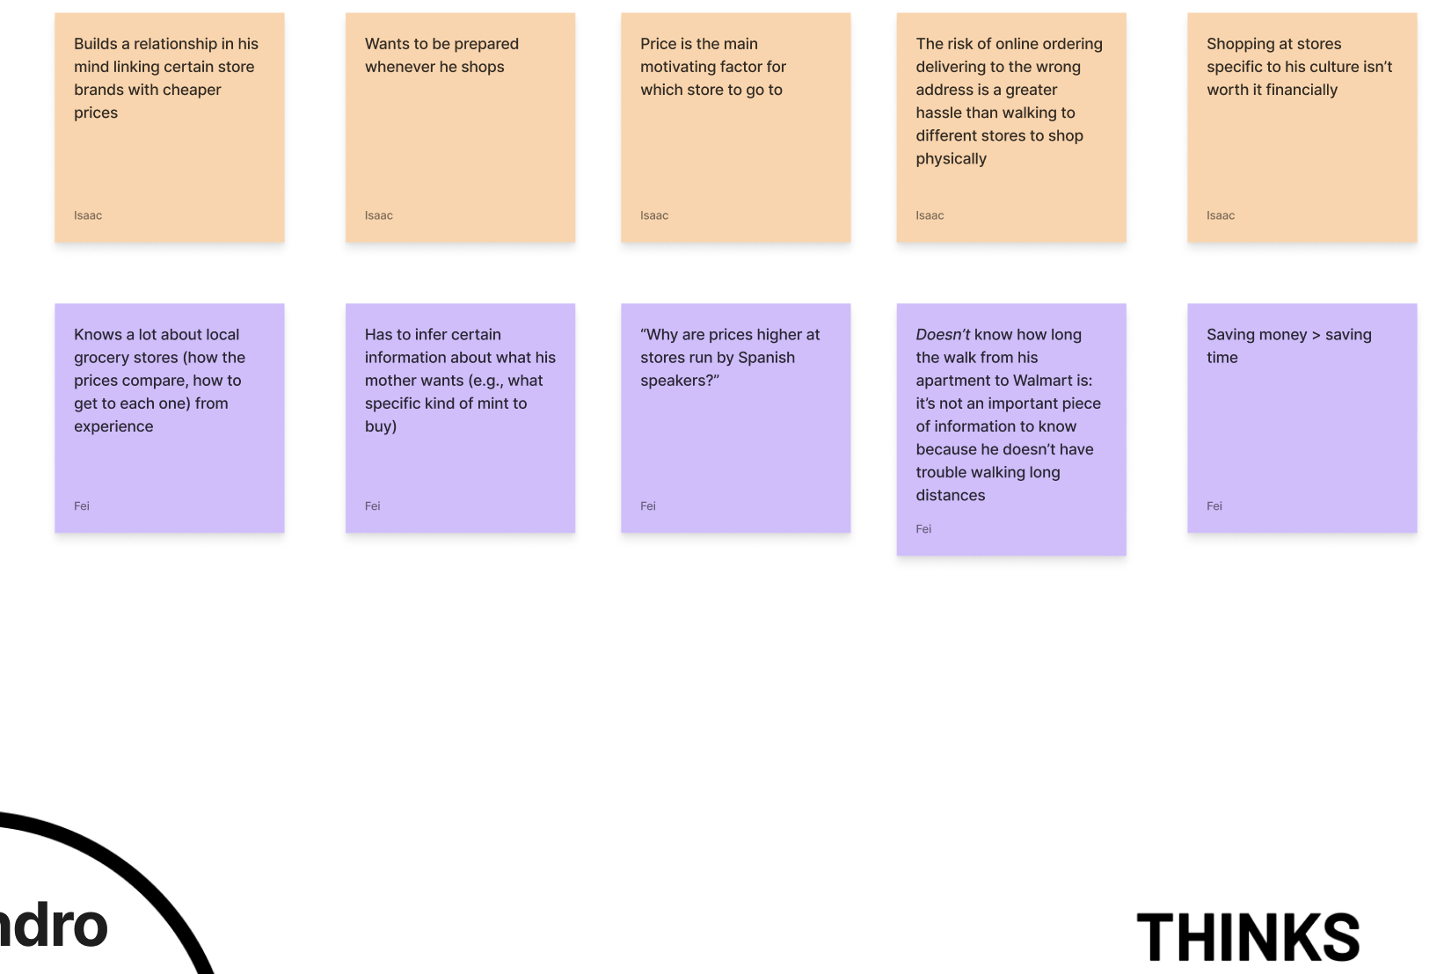
Empathy Maps:
Thinks
Date
Notes:
Doesnt like online because he doesn't trust online or forgets something
Prioritizes / thinks saving money is more important than time

Slide 13
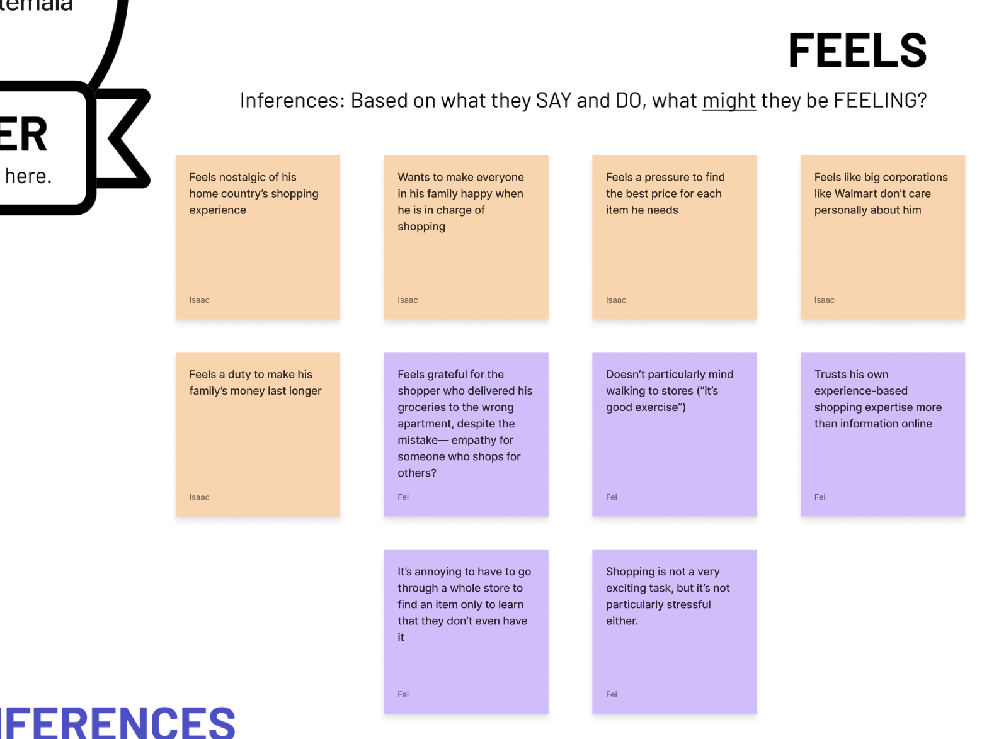
Empathy Maps:
Feels
Date
Notes:
Similar feels that online stores are artificial / inhuman
Trusts his own shopping skills over a computer
Feels that he really needs to save money while making his family happy (not eating bad food); set of standards in terms of quality and price

Slide 14
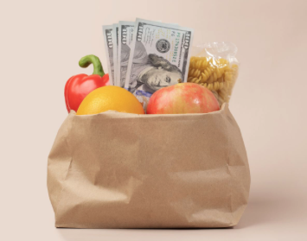
Summary
People want authentic goods; don’t like online and large branded stores
People do not want to spend more money than they think they should
  DEALS, DEALS, DEALS
People trust their guts
Shopping is like a game
  Loyalty programs are key; gaining an advantage
Our domain tightened
  We thought that people are driven by saving time while shopping; but they are much more influenced by saving money and improving their shopping experience
Date

Slide 15


Going to A2
In A1, we discovered our initial assumption was wrong; shoppers are more motivated by saving money
We met extreme shoppers who spent lots of energy deal-hunting on online apps and social media
Began to think about how we might bring authentic shopping back
  How might we enable people to buy what they need without going to stores they don’t like
Also saw the emotional aspect of shopping
  People love trying to find deals
  How might we reduce deal hunting time while still making it fun

Slide 16
Thank you!

